Slide 1

forecasting real-time stock market using An efficient hybrid approach
Reg No and Student name:
126156054 - Jai Adithya A
126003133 – Kiran Soorya R S
126156009 – Anirudh Sooriyamoorthy
Guide:
Dr. PLK PRIYADARSINI

Slide 2
Outline of this Presentation
Motivation
Objective
Base Paper
Problem Statement
Literature survey
Modules
Dataset
Work plan
Proposed Techniques (optional)
References

Slide 3
Motivation
The stock market is highly dynamic, with prices fluctuating rapidly due to market sentiment, global events, and economic indicators. Traditional models often fail to capture complex dependencies in stock data
With advancements in machine learning and deep learning techniques, we aim to leverage innovative models in these fields to effectively model and analyze the complexities of the stock market.

Slide 4
Objectives
Data Collection and Preprocessing
Calculation of Technical Indicators
Incremental Model Updates - Train the model on preprocessed historical data and update it incrementally
Validate the model’s performance against traditional forecasting methods.

Slide 5
An efficient hybrid approach for forecasting real-time stock market indices
Authors :
Riya Kalra , Tinku Singh,
Suryanshi Mishra, Satakshi , Naveen Kumar , Taehong Kim , Manish Kumar,
“Journal of King Saud University - Computer and Information Sciences”,
2024, Pages - (1-11)
Indexed in: Scopus / SCI-E
Year : 2024

Slide 6
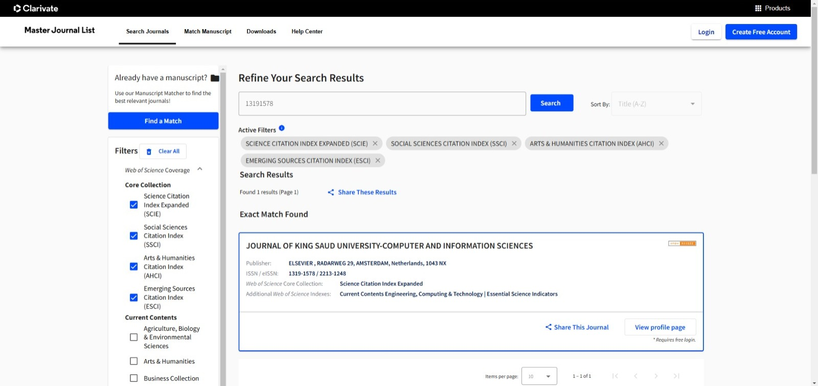
SCIE Indexing

Slide 7
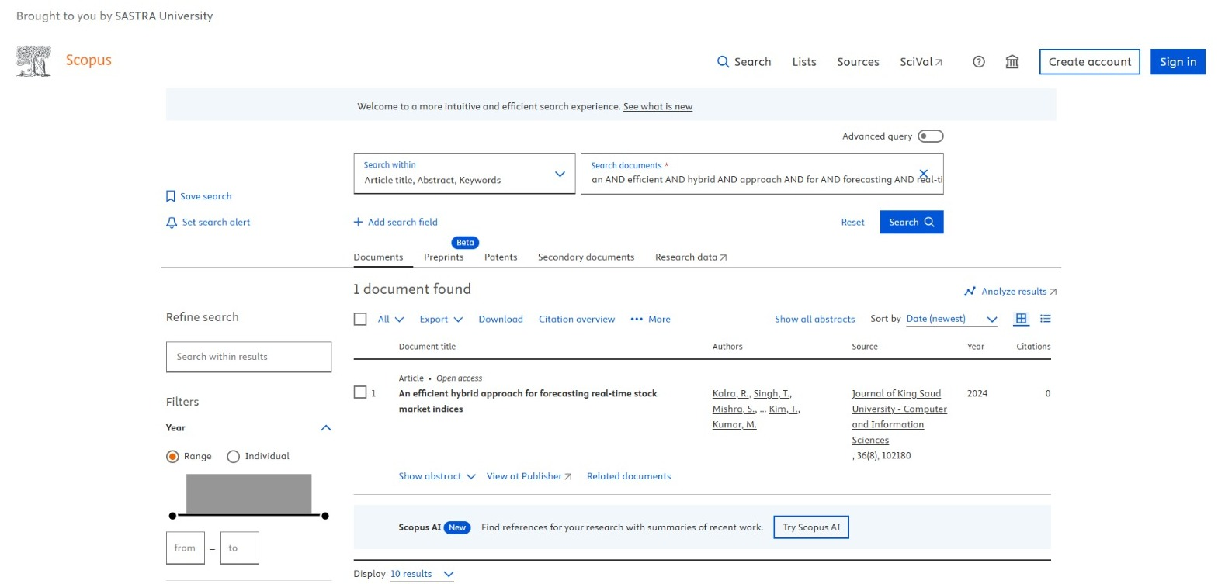
SCOPUS Indexing

Slide 8
Problem Statement
The stock market's inherent volatility, noise, and non-linear nature make accurate price prediction highly complex. Existing machine learning and deep learning models, while promising, face limitations such as high computational demands, real-time update requirements, and extensive hyperparameter tuning. Additionally, incremental learning models struggle to balance stability—preserving past knowledge—and adaptability to new data. Therefore, there is a need for a scalable, efficient, and real-time forecasting approach capable of addressing these challenges.

Slide 9
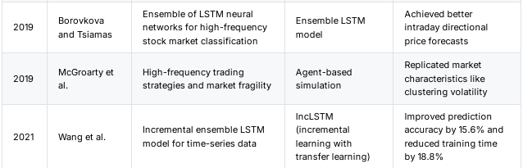
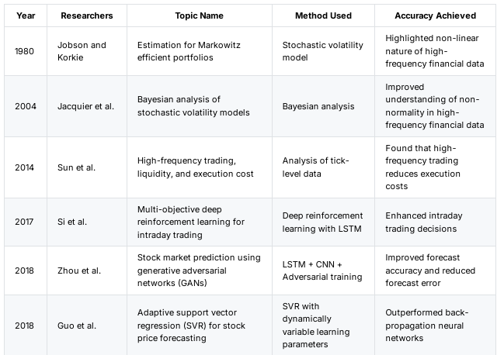
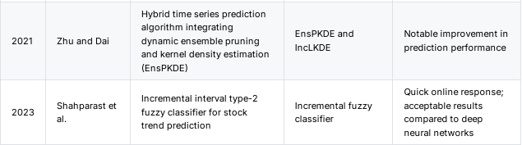
Literature survey

Slide 10
Modules
tvDatafeed or
TradingviewData
TensorFlow PyTorch
scikit-learn
( RMSE, MAE,
MAPE )
Matplotlib
Plotly

Slide 11
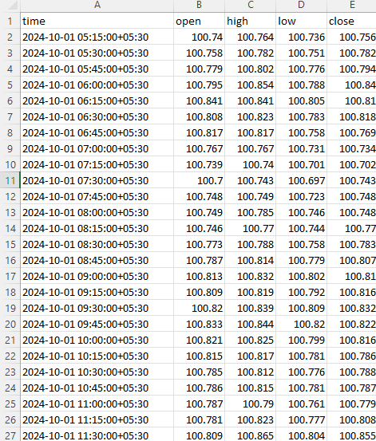
Data-Set
The dataset contains 4 attributes OHLC (open,high,low,close)
This dataset have only numeric datatypes data and time stamps.
We use the recent 6000 records for the proper prediction based on our understanding of the paper

Slide 12
Proposed techniques (Architecture)
Preproessing
LSTM
Linear Regression
Descision Tree
Matplotlib
Seaborn
MAE AND MAPE
RMSE
DATASET
RESULTS

Slide 13
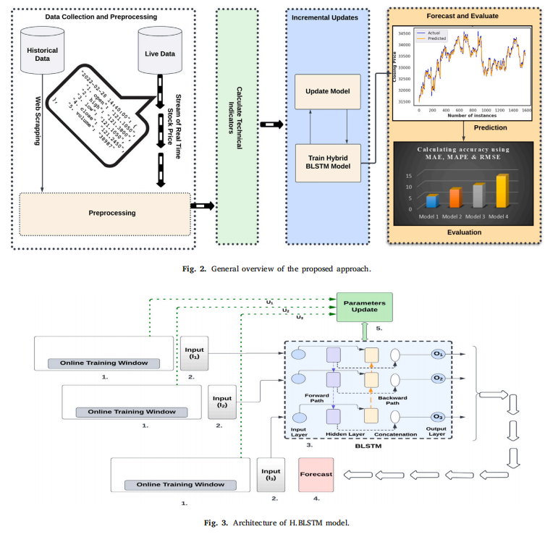
Proposed techniques (Architecture)

Slide 14
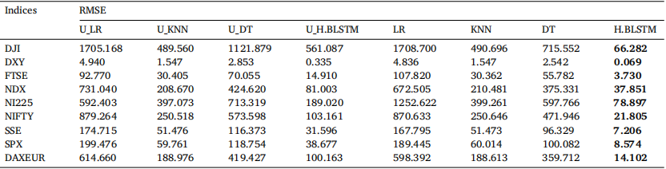
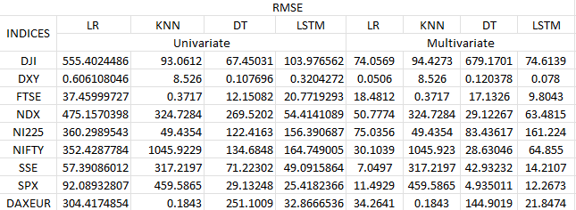
Results Comparison - Rmse
Achieved in the research paper
Achieved through the prescribed model

Slide 15
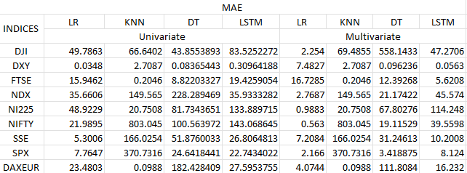
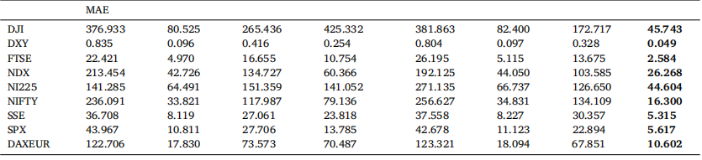
Results Comparison - mae
Achieved in the research paper
Achieved through the prescribed model

Slide 16
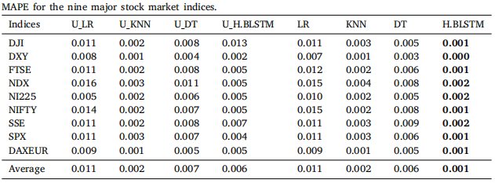
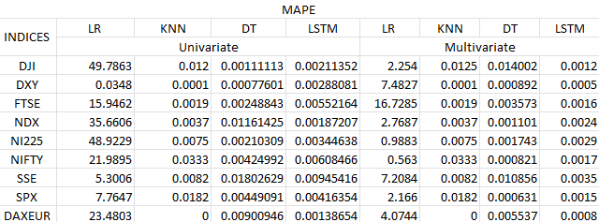
Results Comparison - mape
Achieved in the research paper
Achieved through the prescribed model

Slide 17
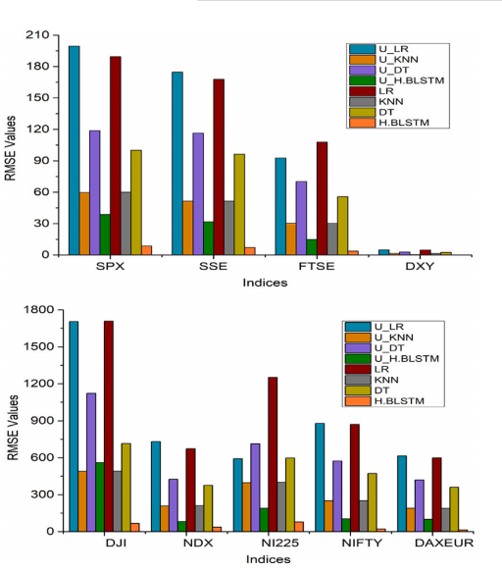
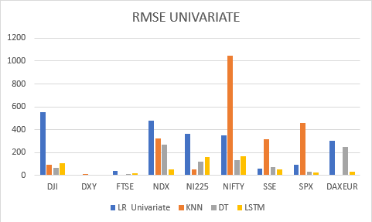
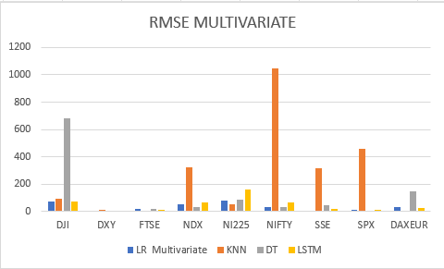
Visual Comparison - barchart
Achieved in the research paper
Achieved through the prescribed model

Slide 18
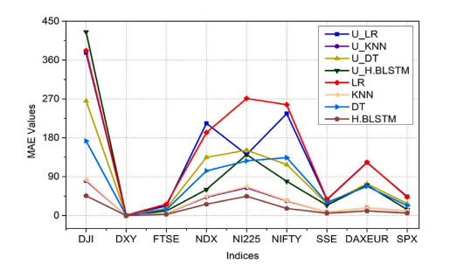
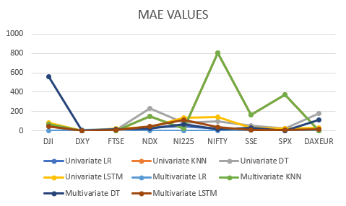
through line graph
Achieved in the research paper
Achieved through the prescribed model

Slide 19
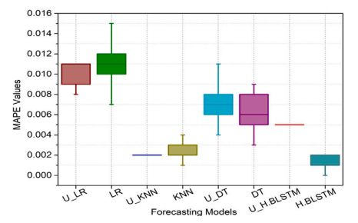
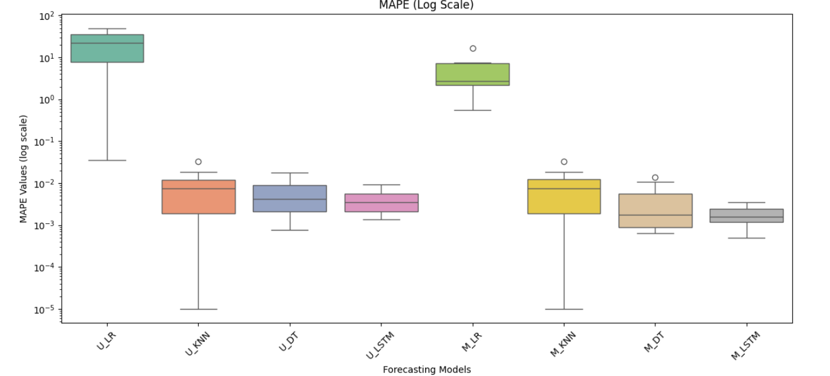
through box plot
Achieved in the research paper
Achieved through the prescribed model

Slide 20
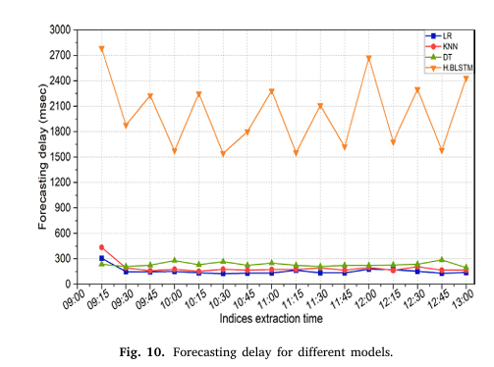
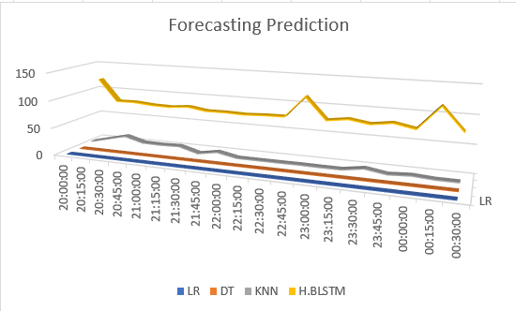
through LaTENCY plot
Achieved in the research paper
Achieved through the prescribed model

Slide 21
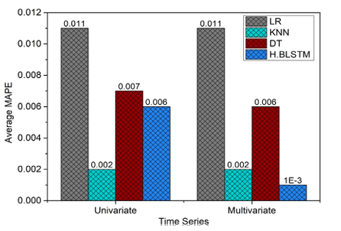
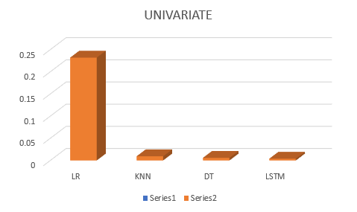
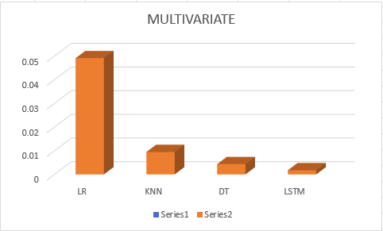
through LaTENCY plot
Achieved in the research paper
Achieved through the prescribed model

Slide 22
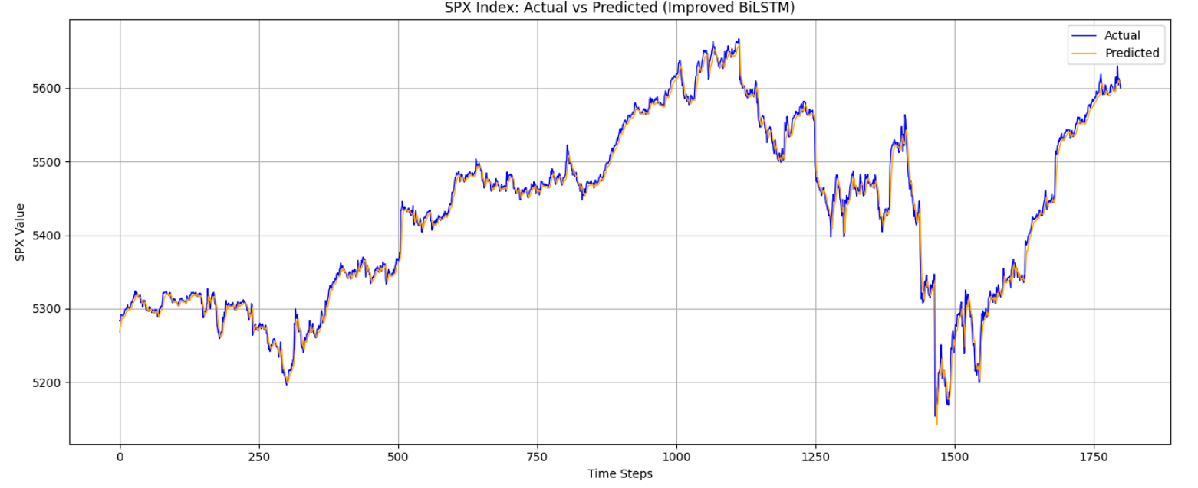
through MODEL plot
Achieved through the prescribed model

Slide 23
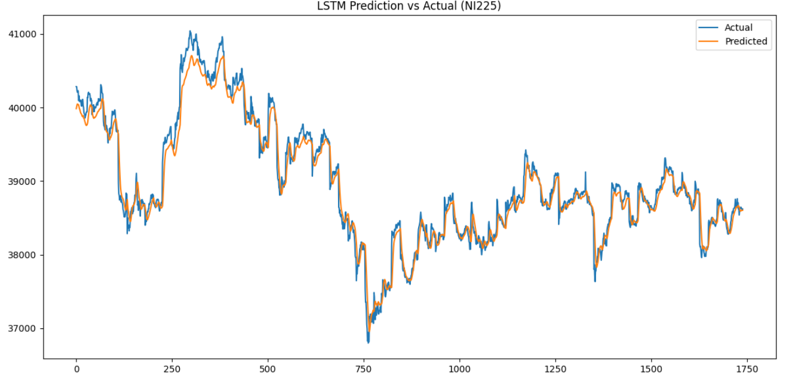
through MODEL plot
Achieved through the prescribed model

Slide 24
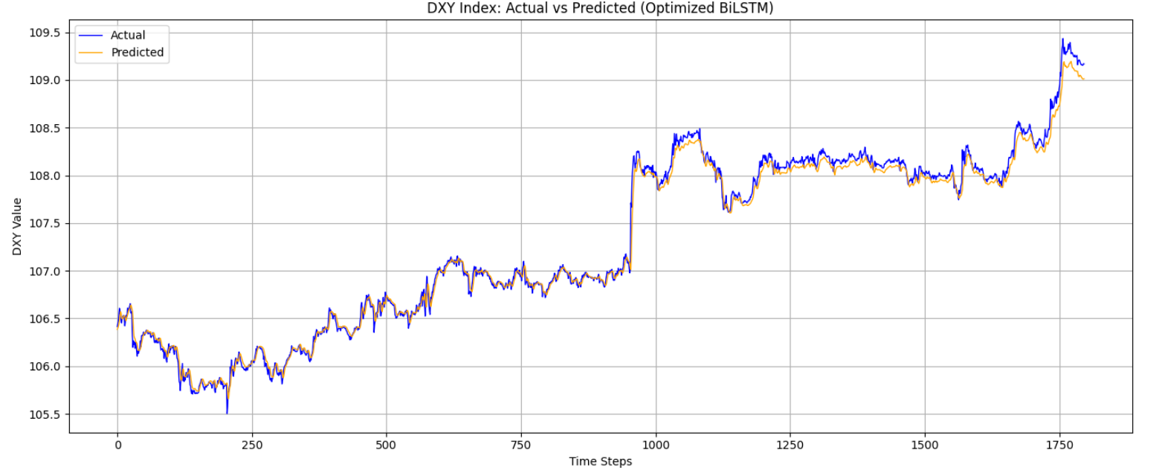
through MODEL plot
Achieved through the prescribed model

Slide 25
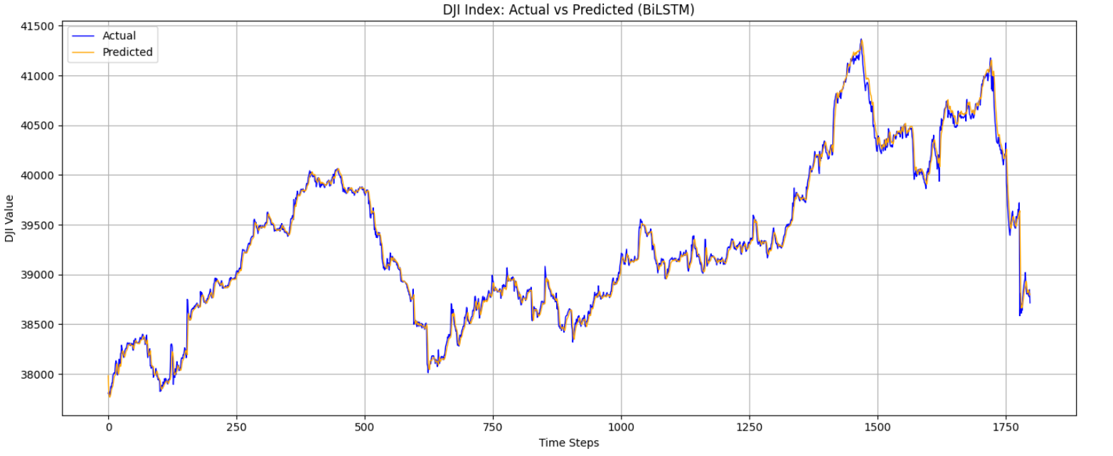
through MODEL plot
Achieved through the prescribed model

Slide 26
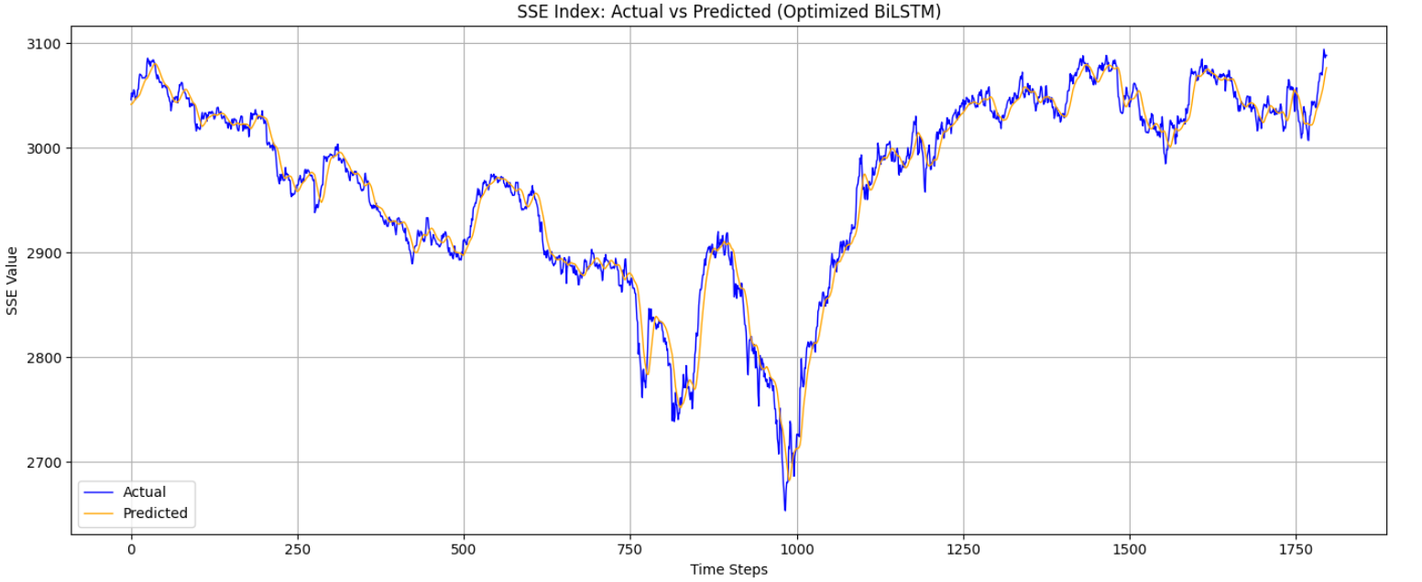
through MODEL plot
Achieved through the prescribed model

Slide 27
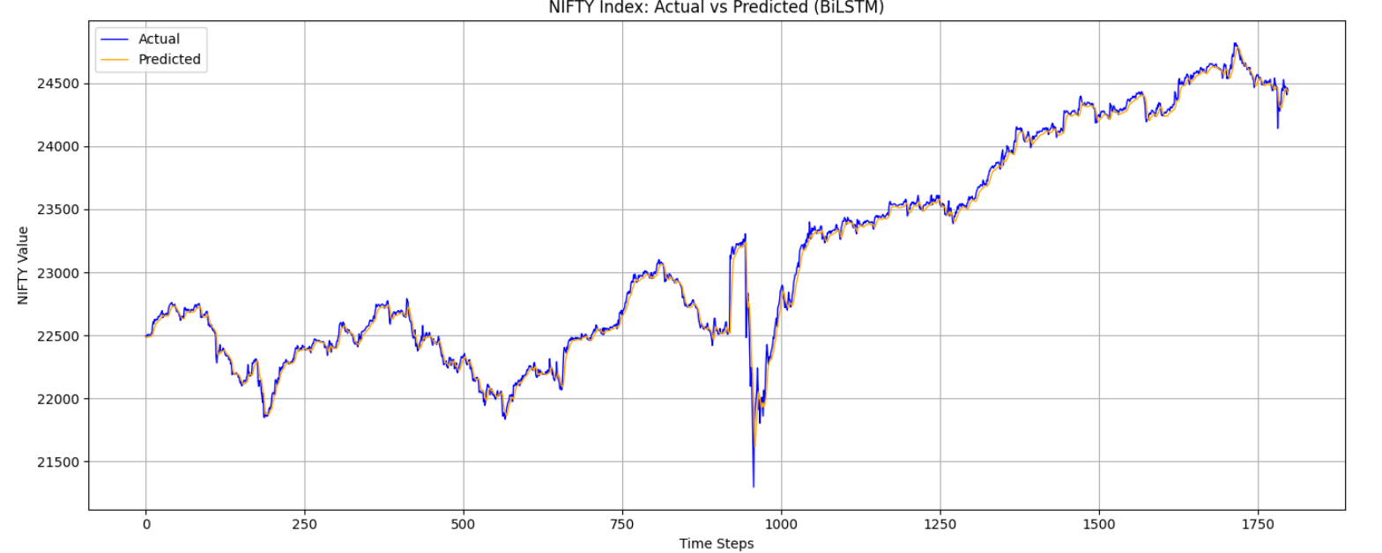
through MODEL plot
Achieved through the prescribed model

Slide 28
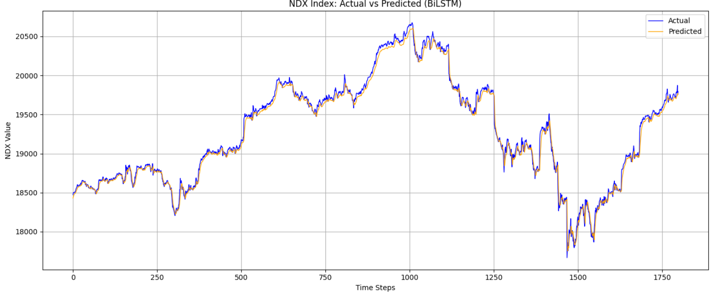
through MODEL plot
Achieved through the prescribed model

Slide 29
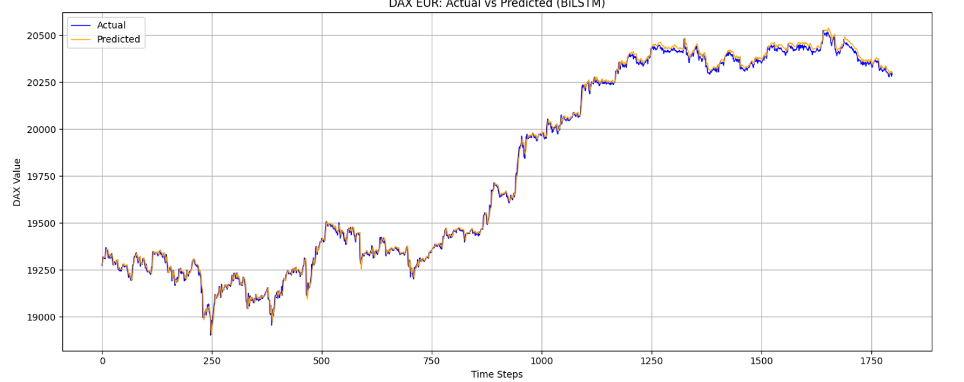
through MODEL plot
Achieved through the prescribed model

Slide 30
R e f e r e n c e s
Ap Gwilym, O., Sutcliffe, C., 2012. Problems encountered when using high frequency financial market data: suggested solutions. J. Financ. Manag. Anal. 25 (2).
Borovkova, S., Tsiamas, I., 2019. An ensemble of LSTM neural networks for high-frequency stock market classification. J. Forecast. 38 (6), 600–619.
Chen, Z., Liu, B., 2018. Lifelong machine learning. Synth. Lect. Artif. Intell. Mach. Learn. 12 (3), 1–207.
D’Angelo, G., Ficco, M., Robustelli, A., 2023. An association rules-based approach for anomaly detection on CAN-bus. In: International Conference on Computational Science and Its Applications. Springer, pp. 174–190.
D’Angelo, G., Palmieri, F., Robustelli, A., 2021. Effectiveness of video-classification in android malware detection through api-streams and cnn-lstm autoencoders. In:International Symposium on Mobile Internet Security. Springer, pp. 171–194.
Domingos, P., Hulten, G., 2000. Mining high-speed data streams. In: Proceedings of the Sixth ACM SIGKDD International Conference on Knowledge Discovery and Data Mining. pp. 71–80.

Slide 31
THANK YOU

